Slide 1
SCILAB PRESENTATION
TOPICS
Eigen values and Eigen Vectors
Inverse of Matrix
Diagonalisation of Matrices
Gauss Elimination Method using Matrices
Mesh Analysis
Gauss Seidel Method
Coupled Mass Oscillator

Slide 2
BENEFITS OF SCILAB + APPLICATIONS
Free and open source, user friendly numerical and computational package
Available for various operating systems like Windows, Linux and Mac OS/X
Users can see and modify the source code
It can perform multiple operations like:
Matrix Operations
Audio and Video Processing(SIVP)
2D and 3D plotting
It is used in private industries, by entrepreneurs, defense establishments, research organizations and individual users.

Slide 3
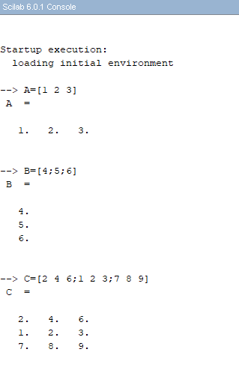
BASICS OF MATRICES
In Scilab, a matrix is presented in the following way:
Row Matrix
Column Matrix
A 3x3 Matrix

Slide 4
EIGEN VALUES AND EIGEN VECTORS
Eigenvalues are a special set of scalars associated with a linear system of equations (i.e., a matrix equation) that are sometimes also known as characteristic roots, characteristic values.
Its common applications in physics are as stability analysis, the physics of rotating bodies, and small oscillations of vibrating systems.
Mathematical Explanation
Almost all vectors change direction, when they are multiplied by A. Certain exceptional vectors x are in the same direction as AX. Those are the “eigenvectors”. Multiply an eigenvector by A, and the vector Ax is a number λ times the original x.
The basic equation is Ax=λx.
(A- λI)X=0
The number λ is an eigenvalue of A. The eigenvalue λ tells whether the special vector x is stretched or shrunk or reversed or left unchanged—when it is multiplied by A.

Slide 5
EXAMPLE
Consider a matrix A =
From previous slide, the characteristic eqn is:
det = 0
-2 -4 2
-2 1 2
4 2 5
-2- λ -4 2
-2 1- λ 2
4 2 5- λ
Expanding the determinant,
(-2- λ)[(1- λ)(5- λ)-4]+4[(-2)(5- λ)-8]+2[(-4)-4(1- λ)]=0
On solving, we get values of λ as 3, -5 and 6 which are known as eigen values of matrix A.
We now solve
=0
For each eigen value i.e. 3,-5 and 6
Every such system will have infinitely many solutions
We will try to find eigen vectors by keeping the simplest values of x, y and z i.e. =1
On replacing λ with each eigen value, we get different sets of eigen vectors.
-2- λ -4 2
-2 1- λ 2
4 2 5- λ
x
y
z

Slide 6
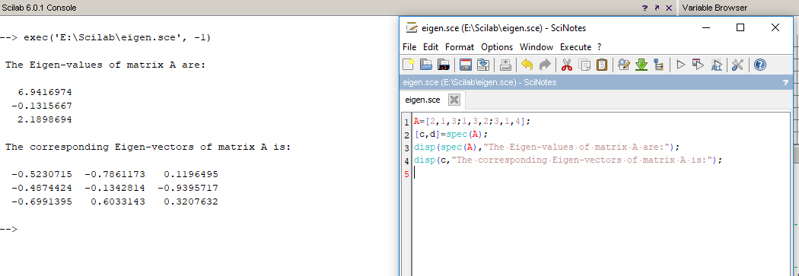
EIGEN VALUES AND EIGEN VECTORS
Using Scilab
Scilab has an inbuilt function called spec(A) to calculate Eigen values of a matrix A.
Syntax
[c,d]=spec(A)
where d is a diagonal matrix which contains the eigen-values, and c is a matrix that stores the eigen-vectors as its columns.

Slide 7

INVERSE OF A MATRIX
For a square matrix A, the inverse is written A⁻¹. When A is multiplied by A⁻¹ the result is the identity matrix I. Non-square matrices do not have inverses.
Not all square matrices have inverses. A square matrix which has an inverse is called invertible or nonsingular, and a square matrix without an inverse is called noninvertible or singular.
AA⁻¹ = A⁻¹A = I
A⁻¹ = (adjoint of A) or A⁻¹ = (cofactor matrix of A)^{T}

Slide 8
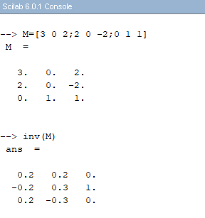
INVERSE OF A MATRIX
Using Scilab
Scilab has an inbuilt function called inv(A) to calculate Eigen values of a matrix A.
Syntax
B=inv(A)
where B is the inverse matrix of A,

Slide 9
DIAGONALISATION OF MATRIX
Diagonalization is the process of finding a corresponding diagonal matrix for a diagonalizable matrix or linear map. A square matrix that is not diagonalizable is called defective.
A diagonal matrix is a square nxn matrix with non zero entries only along its main diagonal.
D=P⁻¹AP
Where P is an invertible matrix and D is diagonal matrix

Slide 10
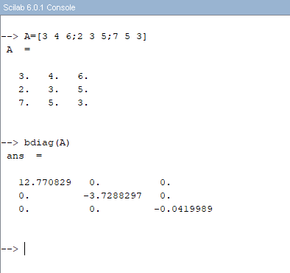
DIAGONALISATION OF MATRIX

Slide 11


GAUSS ELIMINIATION METHOD USING MATRICES
Gaussian elimination is a method for solving matrix equations of the form
Ax=b
To perform Gaussian elimination starting with the system of equations
compose the "augmented matrix equation"

Slide 12
GAUSS ELIMINIATION METHOD USING MATRICES (Using Example)
2x₂ + x₃ = −8
x₁ − 2x₂ − 3x₃ = 0
−x₁ + x₂ + 2x₃ = 3.
Augmented Matrix will be,
0 2 1 −8
1 −2 −3 0
−1 1 2 3
Swap Row 1 and Row 2
1 −2 −3 0
0 2 1 −8
−1 1 2 3
Add Row 1 to Row 3
1 −2 −3 0
0 2 1 −8
0 −1 −1 3
Swap Row 2 and Row 3
1 −2 −3 0
0 −1 −1 3
0 2 1 −8
Add twice Row 2 to Row 3.
1 −2 −3 0
0 −1 −1 3
0 0 −1 −2

Slide 13
Add -1 times Row 3 to Row 2
Add -3 times Row 3 to Row 1
1 −2 0 6
0 −1 0 5
0 0 −1 −2
Multiply Rows 2 and 3 by -1
1 0 0 -4
0 1 0 -5
0 0 1 2
We get,
x₁=-4
x₂=-5
x₃=2

Slide 14
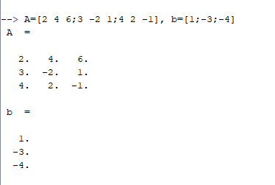
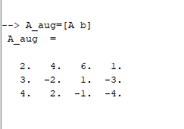
GAUSS ELIMINIATION METHOD USING MATRICES (Under Scilab)
In Scilab, for a given matrix A and a vector b;
Augmented matrix A_{aug} can be written as:

Slide 15
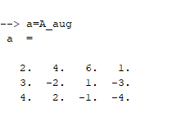
GAUSS ELIMINIATION METHOD USING MATRICES (Using Scilab)
To show first step of forward elimination in Scilab, we first copy the augmented matrix we created into an array a by using
Next, we write the algorithm in Scinotes

Slide 16
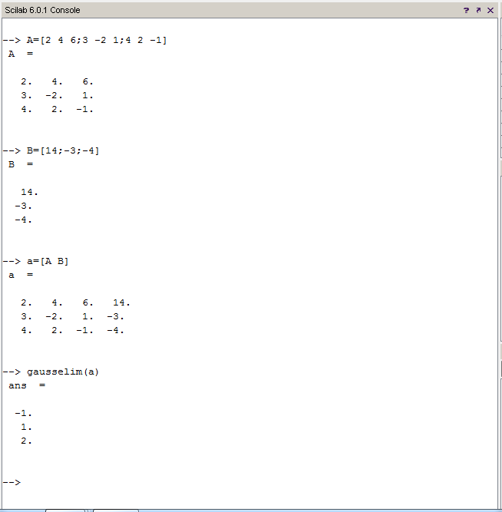
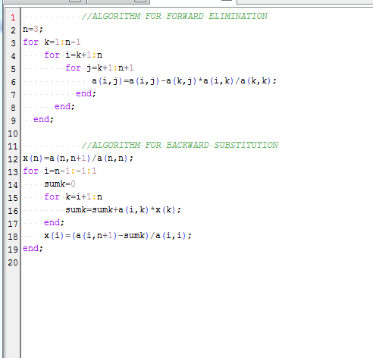
GAUSS ELIMINIATION METHOD

Slide 17
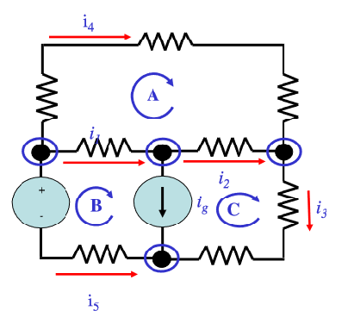
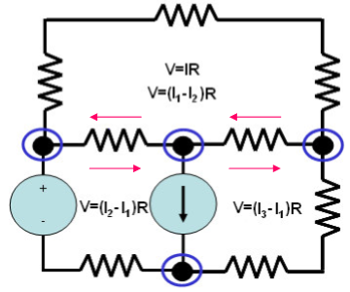
MESH ANALYSIS
A mesh is a loop which does not contain any other loops within it.
Firstly, we identify the number of basic meshes. Three in this case.
Then, we assign a current to each mesh.
Then, we apply Kirchoff’s Voltage Law around each loop to get system of linear equations in terms of the loop currents i.e.
R11 R12 R13 I1 V1
R21 R22 R23 I2 V2
R31 R32 R33 I3 V3
RESISTANCE CURRENT VOLTAGE
By solving these linear equations by gauss elimination method, we get the result of I_{1,} I₂ and I₃

Slide 18
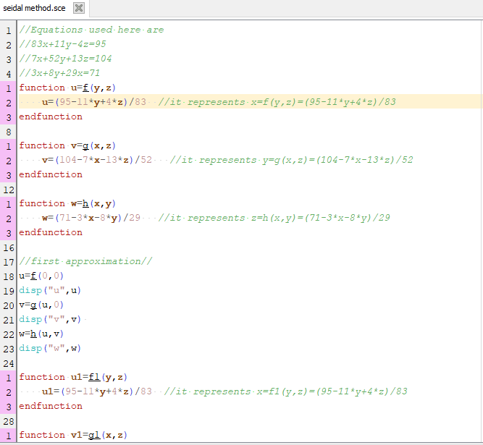
GAUSS SEIDEL METHOD

Slide 19
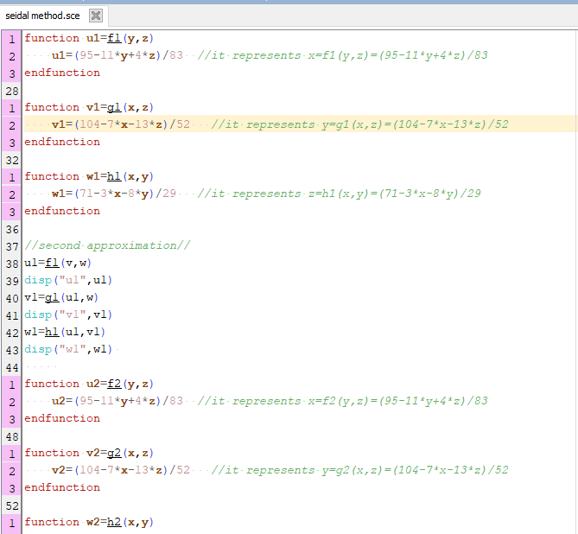
GAUSS SEIDEL METHOD

Slide 20
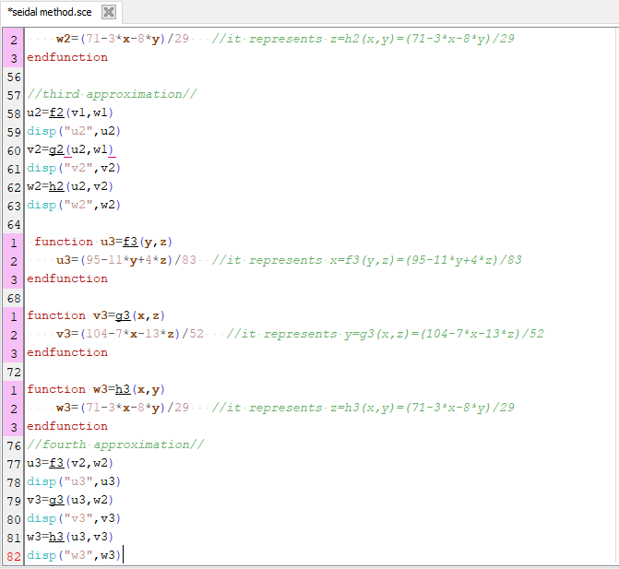
GAUSS SEIDEL METHOD

Slide 21
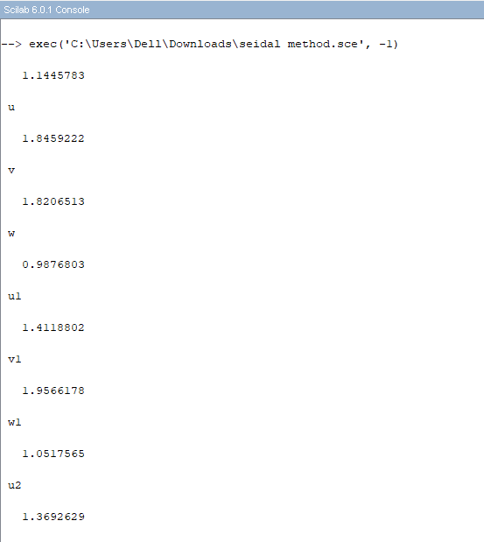
GAUSS SEIDEL METHOD

Slide 22
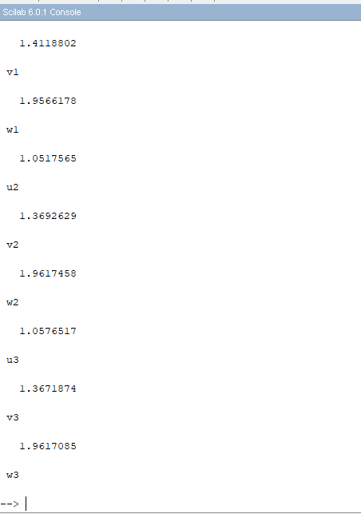
GAUSS SEIDEL METHOD

Slide 23
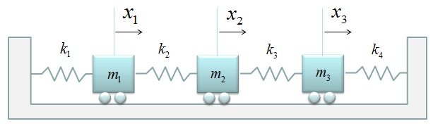
COUPLED SPRING MASS SYSTEM
Let the masses M₁, M₂, M₃ be displaced by distances x₁, x₂, x₃.
Now applying Newton’s Law on M₁
M₁x₁’’=-kx₁+k(x₂-x₁)
X₁’’=[-kx₁+k(x₂-x₁)]/M₁
X₁’’=[-2kx₁+kx₂]/M₁
Now applying Newton’s Law on mass M2
M₂x₂’’=-k(x₂-x₁)+k(x₃-x₂)
X₂’’=[-k(x₂-x₁)+k(x₃-x₂)]/M₂
X₂’’=[-2kx₂+kx₁+k₃]/M₂
Now applying Newton’s Law on mass M3
M₃x₃’’=-kx₃-k(x₃-x₂)
X₃’’=[-kx₃-kx₃+kx₂]/M₃
X₃’’=[-2kx₃-kx₂]/M₃

Slide 24
Acknowledgement
We have completed this project work with the help of knowledge imported by the teachers and PhD scholars. We are very greatful to our teacher Dr. Lokesh Kumar who acted as our guiding light .We also thank the research scholars
Mr. Sandeep Dudi
Ms. Tejpreet Kaur
Mr. Manoj Kaur
Ms. Divanshi Sharma
We are also thankful to everyone who have supported us for that we have completed our project effectively and more over on time . We have gained a lot of knowledge which would be very helpful to us in future .

Slide 25
THANK YOU

